Slide 1


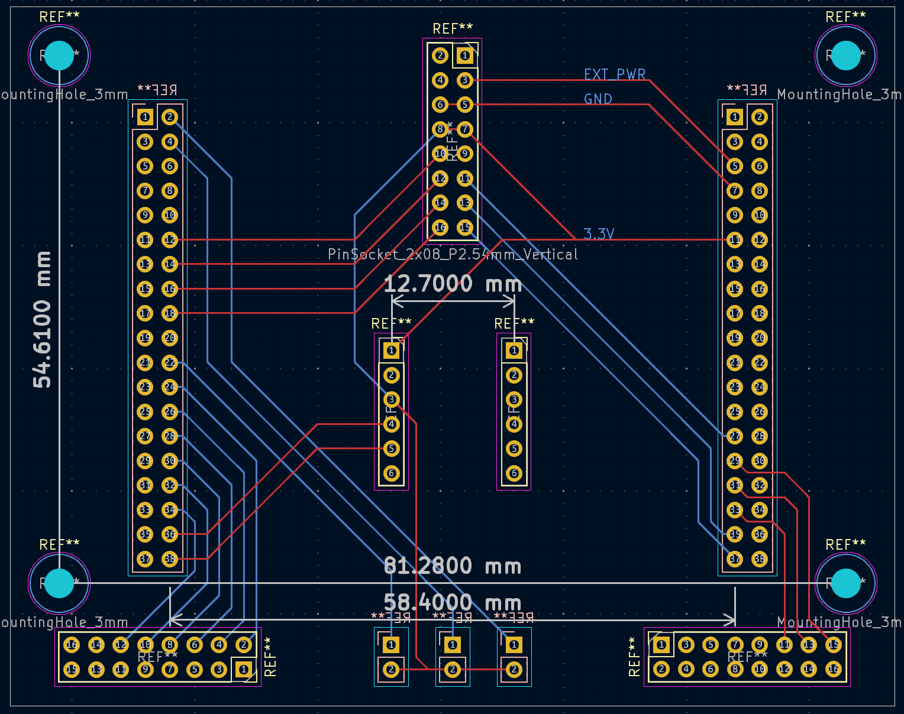
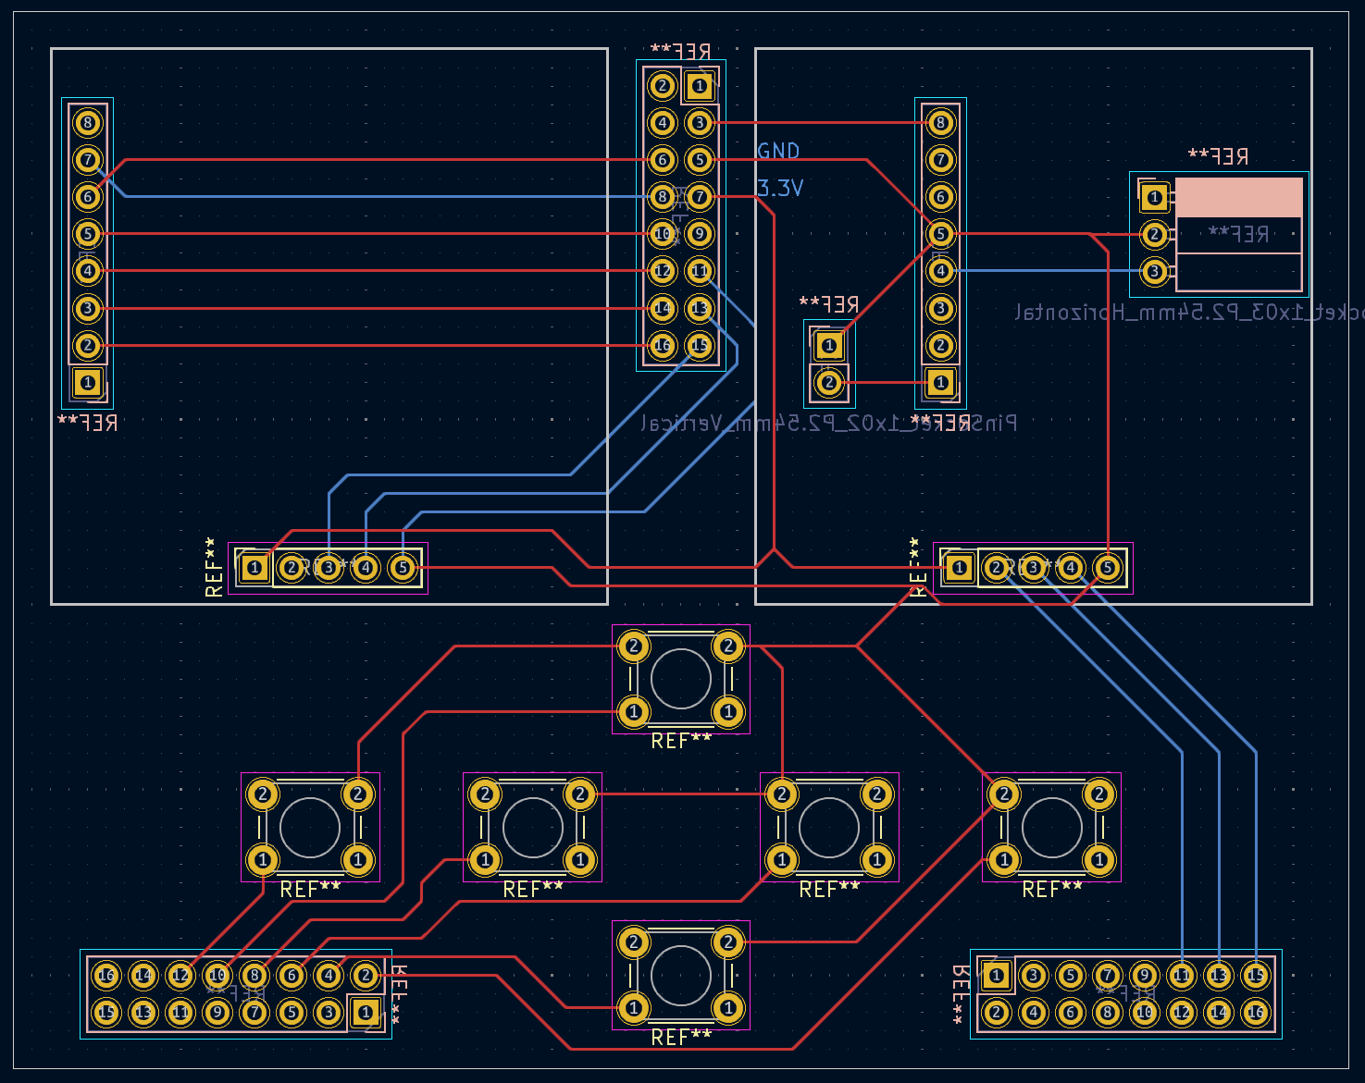
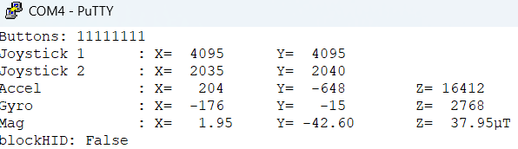
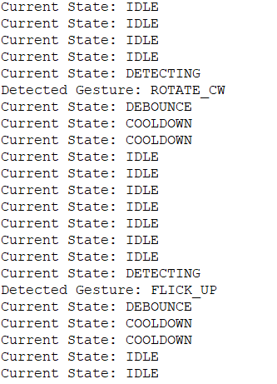
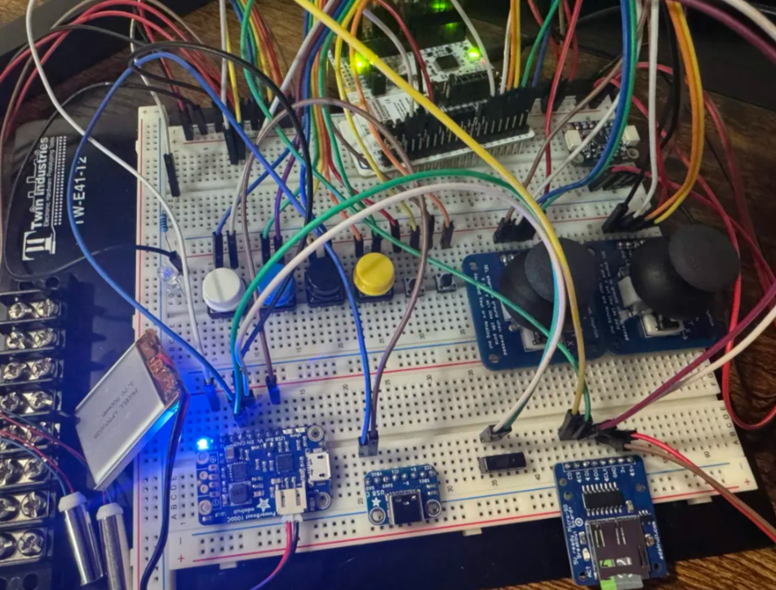
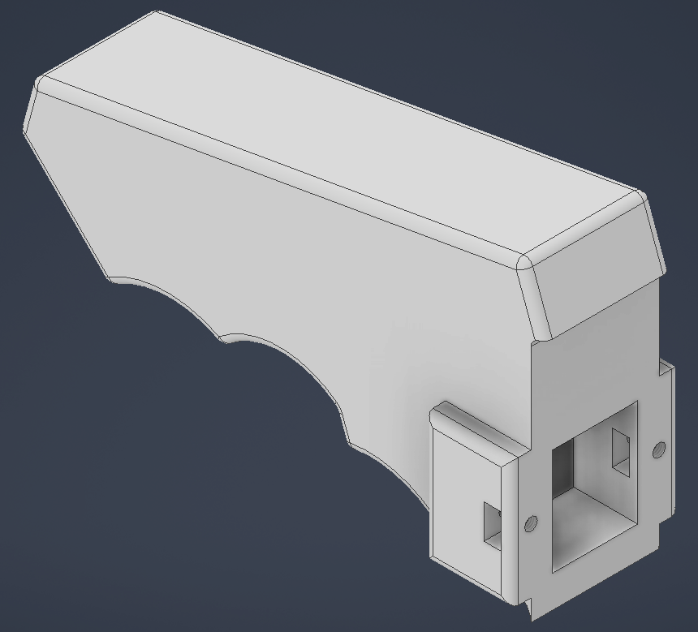
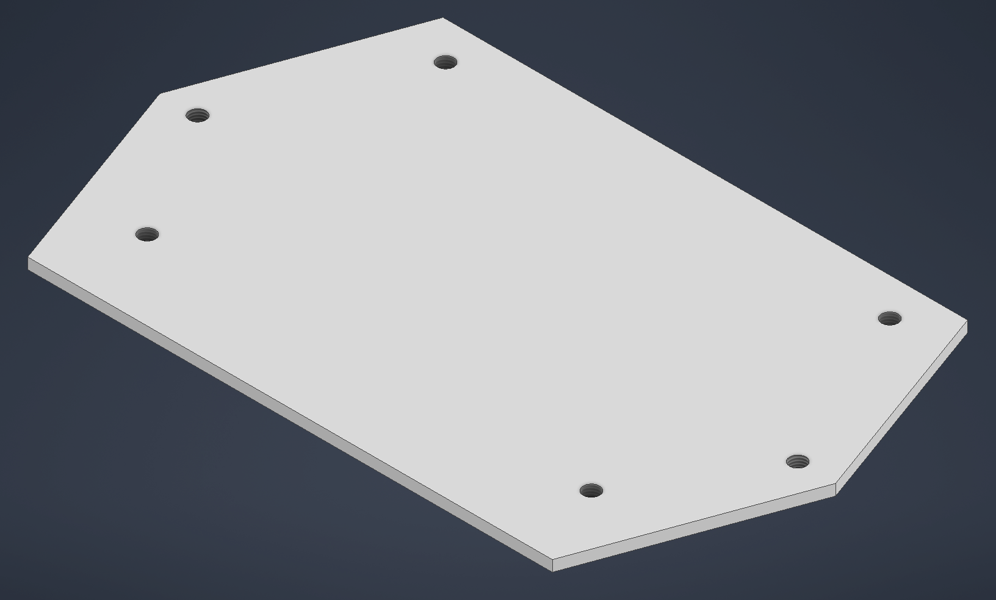
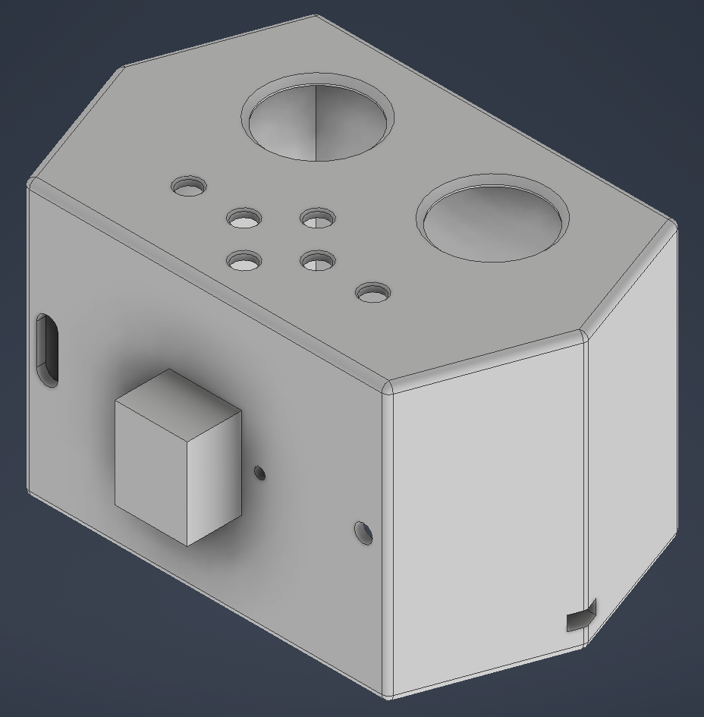
Monochuck Adaptive Gyro Controller
Embedded Systems Senior Project
Landen Barber
June 2026
Introduction
Method
Results
Problem
Most gyro controllers use fixed sensitivity curves that do not adapt to how different users naturally move their wrists. This forces users to manually adjust settings or adapt their own movements to fit the device. My controller solves this with adaptive assistance that learns user movement patterns and automatically adjusts sensitivity, filter strength, and gesture detection over time.
Solution
My senior project is a one-handed accessibility controller which primarily uses gyro-based input to control computer actions like cursor movement and inputs using gestures. The device also provides adaptive assistance allowing it to learn the user’s movement patterns and automatically adjust configurable values including sensitivity, filter strength, and gestures detection.
Key Innovation
The adaptive assistance of this device is what sets it apart from other gyro-based devices, by continuously logging user movement data and inputs, It put those numbers into an algorithm which analyzes patterns and averages and recommends changes to settings that has the potential of making the device match a specific user better. This reduces the need to fine tune any settings and eliminates any otherwise manual configuration.
PCB
Two Board Stacked Layout – Bottom board mounts microcontroller and IMU; top board holds joysticks, buttons, and power circuitry
Board-to-Board Connection – Pin sockets and pin headers connect the two PCBs vertically, minimizing footprint while allowing removeable parts.
Designed in KiCad – Four usable maximize component density in a compact form factor
PCB Design Complete, though shipment was delayed multiple times.
Cad models complete and printed.
Hardware integration functional utilizes GPIO, ADC, I2C, SPI, and DMA to bring it all together.
Power systems operational allowing charging without any cutoff.
Gesture detection working.
Adaptive analyzer pattern detection logic designed – uses SD card reader with FatFS for data logging and storage.
3d Model Design
Three-Part Enclosure – Controller head, handle, and backplate designed in Autodesk Inventor for simplified assembly and printing.
Internal Mounting – PCB attaches to backplate via standoffs and M3 screws handle secures to head with more M3 screws and mounting block for stability.
Conclusions
Project Significance
This controller fills a gap between standard gyro peripherals and specialized single-handed devices, offering adaptive assistance that learns user behavior over time and adjusts itself in accordance.
Key Takeaway
The adaptive analyzer is the core innovation whereas no manual configuration should be needed. the controller automatically adjusts sensitivity, filter strength, and gesture thresholds to match each user's natural movements.
Future Work
PCB needs to be soldered, Bluetooth functionality still broken, and many other peculiarities with algorithm still needs to be fixed for this project to be considered acceptable.
Objectives
One-handed design – Symmetrical design which works for either hand.
Gesture detection – Quick inputs based on movement.
Adaptive learning – System self-tunes to your movements making it more convenient to use.
Battery Powered – 500mAh LiPo Battery with USB-C charging and load sharing capability.
Wireless Connectivity – On-board BLE chip utilizing HID protocol
Algorithms
Sensor Filtering – Complementary filter combines gyroscope and accelerometer data for stable orientation; Low-pass and High-pass filters reduce noise and isolate gesture movements
Gesture Recognition – Calculates motion magnitude; triggers commands when magnitude passes adjustable threshold within specified timing window; includes cooldown to prevent false positives.
Adaptive Analyzer
Continuous Data Logging – Records gyro magnitude, tilt angles, timing, and gesture success/failure rates onto Sdcard
Pattern Detection – At periodic intervals, analyzes statistical data including average movement magnitude, common tilt ranges, and repeated gesture activation failures from similar movements in quick succession
Autonomous Adjustment – When patterns are detected, system suggest modifications to change to better match user behavior. Example: If repeat attempts needed to trigger a gesture, algorithm may increase timing window or lowers movement magnitude threshold
No User Configuration Required – All adjustments happen automatically in the background, making the controller more intuitive and comfortable the longer it is used
References
Acknowledgements
Thanks to my colleagues as well as my Senior Project Advisor.

Slide 2
